Slide 1
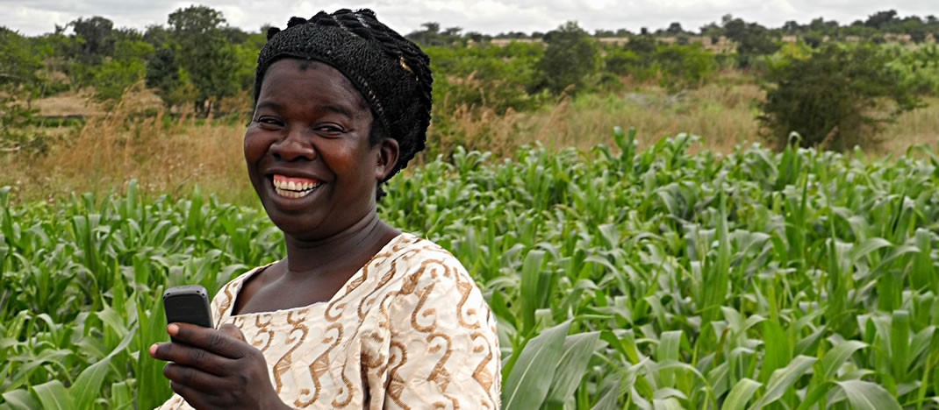
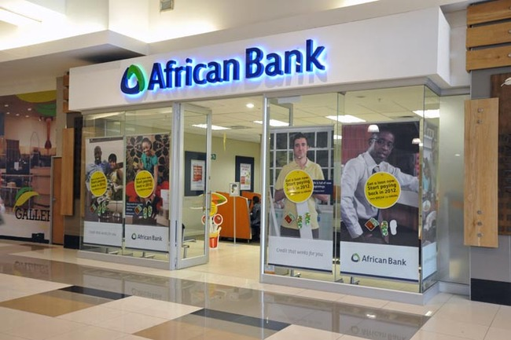
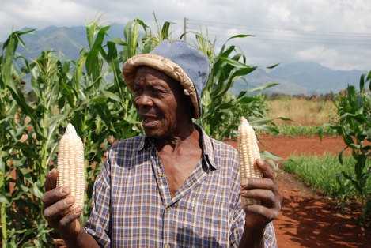
Farmer Financial Profiling
Team 2:
Presented on 18th October 2015 By:
Team Members – Simon Imoro, Samuel Ouko, Eric Kisee, Priscilla, Dr. Ola Ogunyinka, Loyce, Anthony Ochieng at the Hack4Farming event held at Sankara Hotel, Nairobi.

Slide 2

The Challenge.
Financial articulation skills’ gap.
Low on-farm Productivity.
Poor financial and agronomic documentation.
Lack of access to agricultural information.

Slide 3
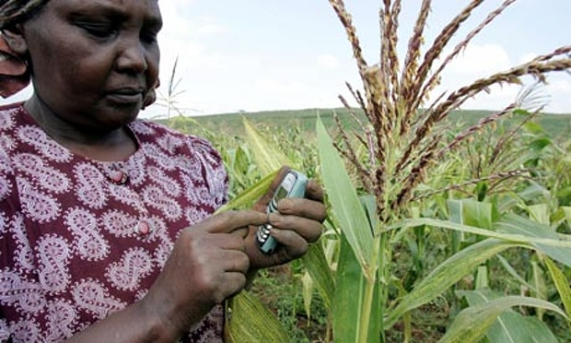
The Innovation.
A mobile farmer-financial instrumentation.
Streamlined agribusiness operational process.
Access to real-time agricultural information.
Actionable data to Government & other value-chain actors.

Slide 4
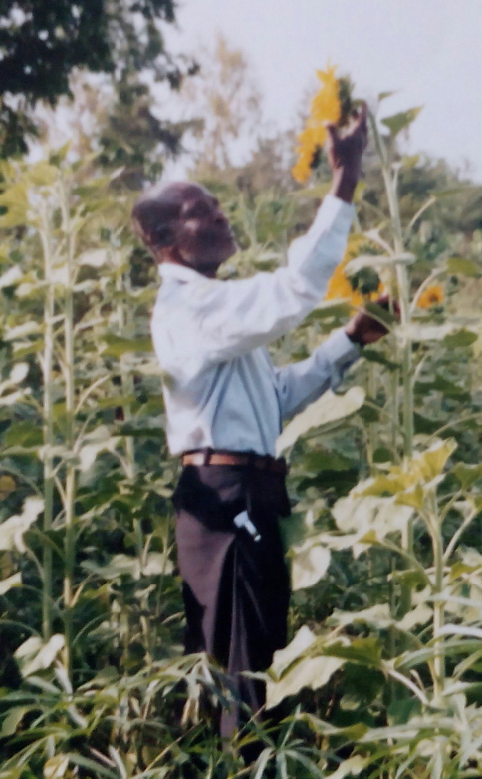
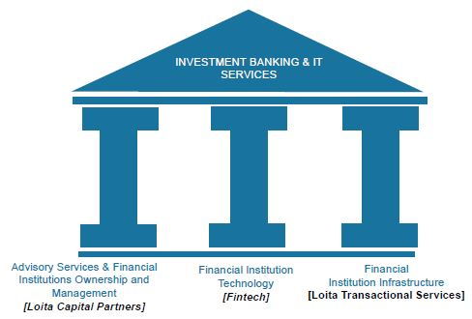

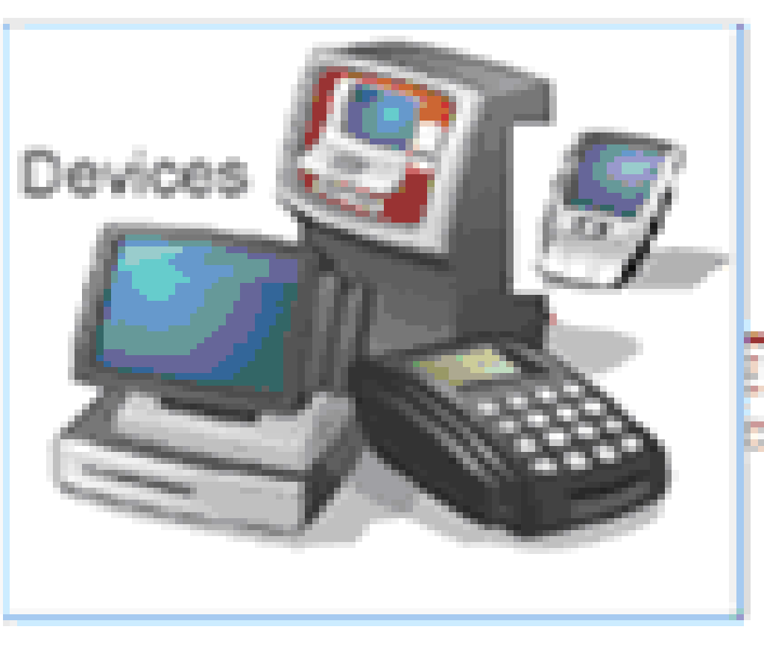
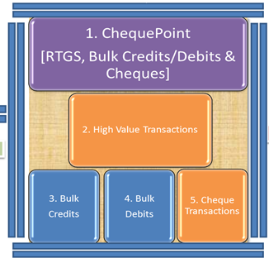


Farmers
Financial Institutions
Database
Da
Stakeholders
Government
Banks
Donors
Farmers
Transporters
Capital, Land, Non Traditional Collateral
Financial Expenses & Income
Extension Officers
Market Prices
Seed Varieties
Geographic, Weather, Climate

Slide 5

The Net Effect.
Improved farmer/bank credit-worthiness assessment processes.
Improved on-farm productivity-Structured cost vs Revenue Analysis.
More targeted government intervention-A repository of actionable data.
Hastened credit access processes to farmers.

Slide 6
Sustainability(Revenue Model)
Farmer USSD/SMS alert subscription charges.
Commissions to vendors on farm inputs purchases.
Bank commissions from business introductions.
Licensing fees from Stakeholders/system third parties

Slide 7

Conclusion

Slide 8
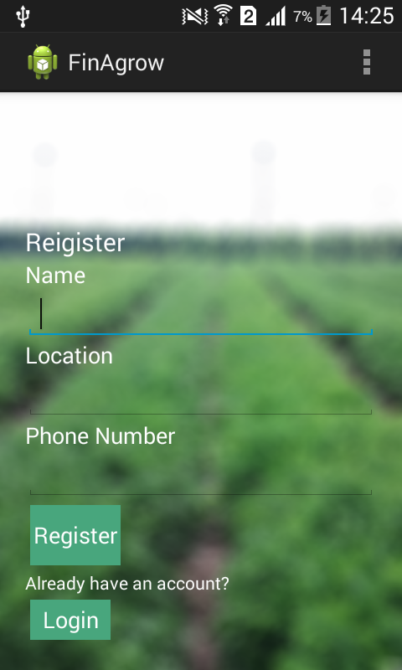
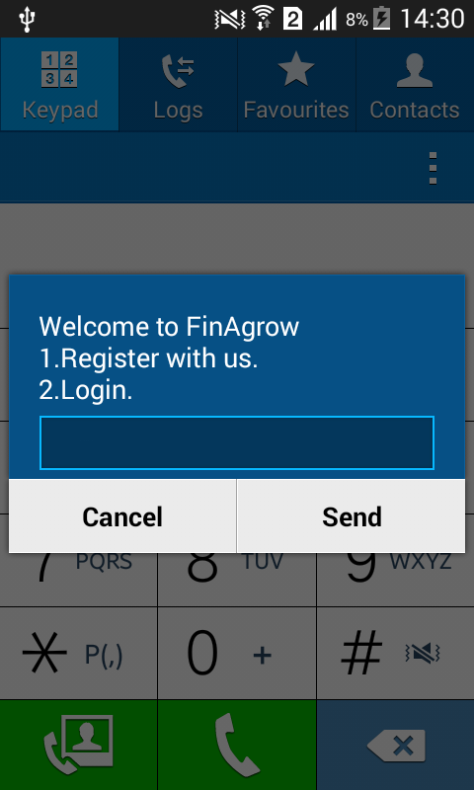

Slide 9
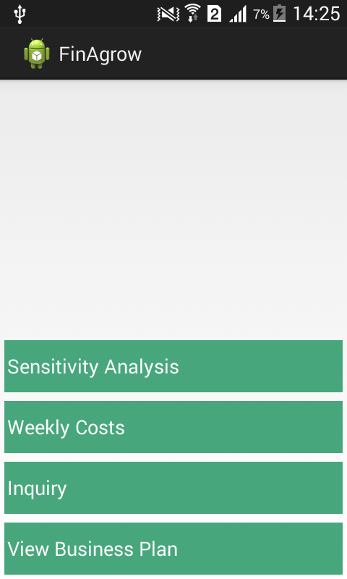
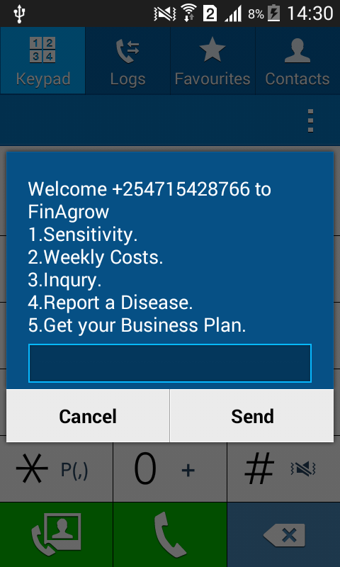

Slide 10
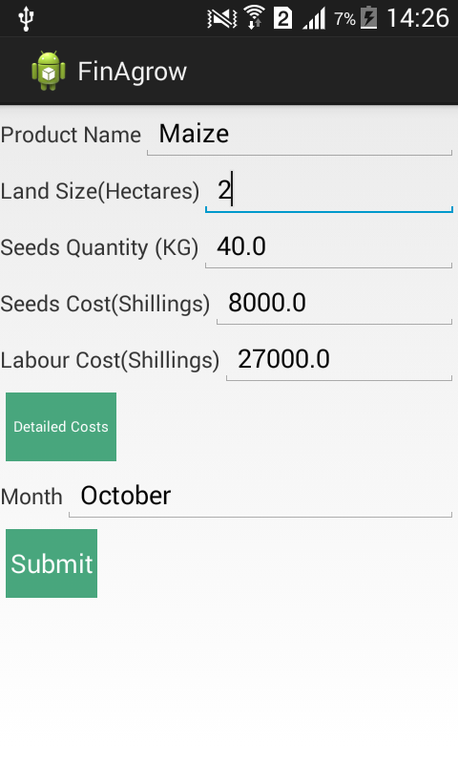
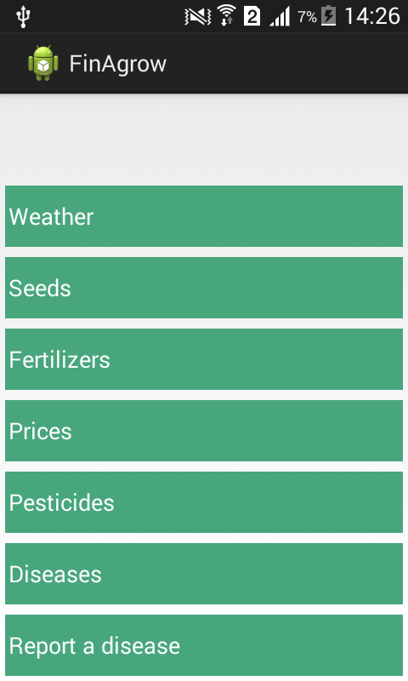

Slide 11
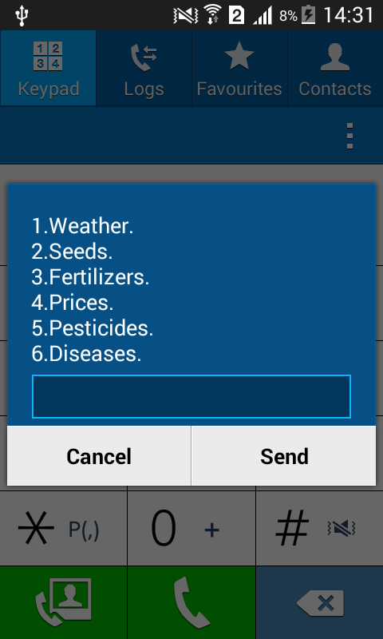

Slide 12
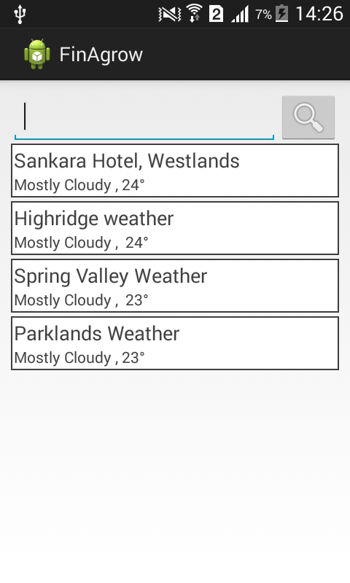
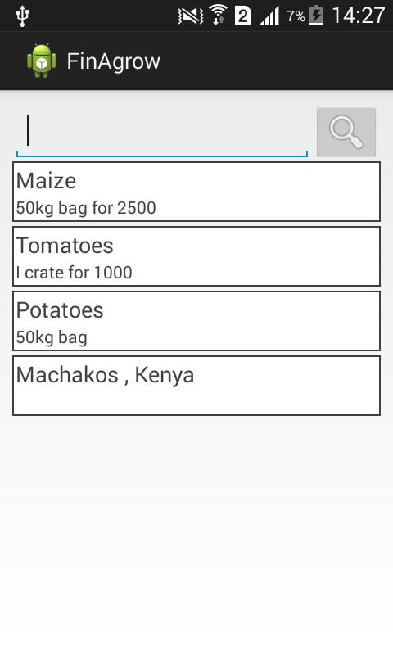

Slide 13
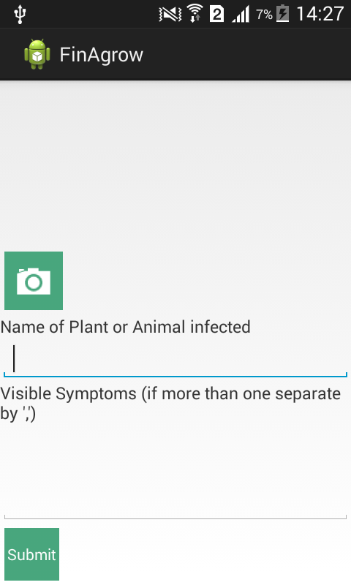


Slide 14


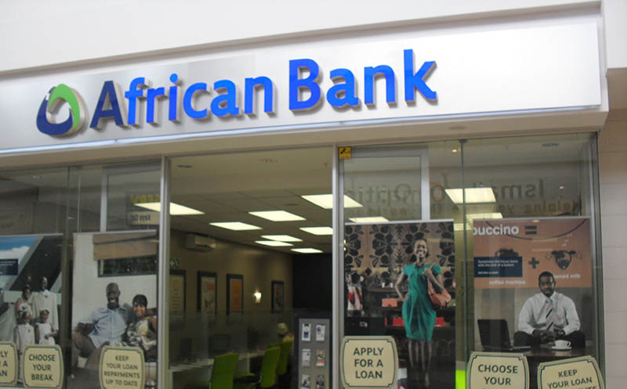
THANK YOU
By
Simon, Samuel, Eric,Loyce,Priscilla,Ola,Anthony
(Team:2)

